Slide 1
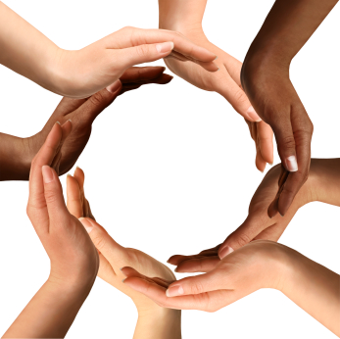
Starting the conversation
Online ymca swim coaches forum
June 16, 2020

Slide 2

welcome
Chad Nico Hiu – Senior Director, Diversity and Inclusion, YMCA of the USA
Karen Friedman – Senior Manager, Access and Ability, YMCA of the USA
Mariejo (MJ) Truex – Senior Director, Education and Programs, USA Swimming

Slide 3
Co-Creating Brave Spaces with youth
Begin by introducing and co-creating a social contract
Ensure adequate time exists and group norms agreed upon by all
Recognize the trauma being experienced by individuals and communities
Grace and space; be gentle and kind to one another
Assume the best of intentions
Understand that each person is speaking from their own personal experience
‘In Person’ conversations are ideal
Avoid asking youth that identify with marginalized populations to educate others on racism, prejudice, or systemic inequities
Avoid Tokenism
Be clear on the audience and desired outcomes of the spaces you aim to create

Slide 4


Further resources
YOUTH GUIDE FOR FACILITATING BRIDGE BUILDING COMMUNICATIONS
https://www.usaswimming.org/news-landing-page/2020/06/12/dei-resources-page

Slide 5
Thank You!
Chad Nico Hiu MJ Truex
YMCA OF THE USA USA SWIMMING
chad.hiu@ymca.net mtruex@usaswimming.org
@chadnico
Karen Friedman
YMCA of the USA
Karen.Friedman@ymca.net
@karenPCV

