Slide 1
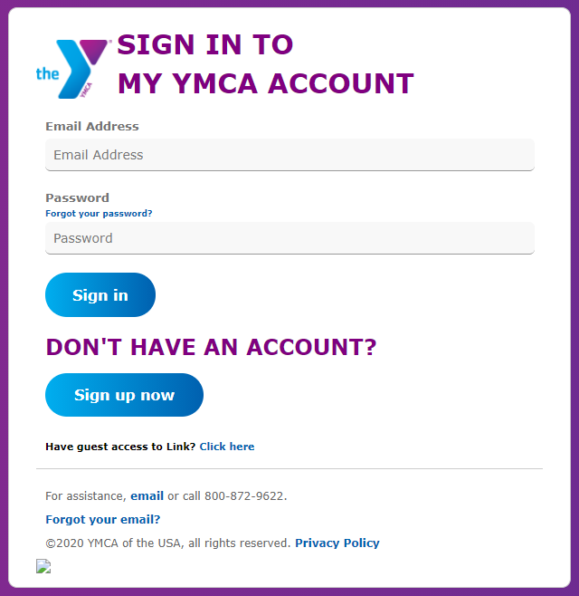
Please Sign In
This will be an interactive training.
Go to https://link.ymca.net
Enter your YMCA Account email and password
If you can’t log in…
Send an email to link@ymca.net.
You can still follow along if desired.
Consider registering for a different time option or request a recording by emailing link@ymca.net.
This session will begin three minutes after official start time to allow
time for participants to Log in to Zoom and sign in to Link.
Notes:
FACILITATOR PREP:
Before you begin, choose a community category and community relevant to this cohort that you will demo. Un-join the community you plan to demo in the script on slide 14 – you will join it during your demo.
Play some tunes during login (optional): Clean Corporate Event Soundtrack (Spotify Free): https://open.spotify.com/playlist/3Xiwa8ul0kWmOE0zbKWbq7?si=976f2dada5834949
Pin the moderators community
Pin the moderators welcome post
Pin this question
Flip between slides 1 and 2 as people are logging in.
Welcome people as they join, specifically at the 10, 5, and 2 minute mark.
Ask people to log in to link and share which communities they are moderators for and something Y-appropriate they are currently “obsessed” with– this could be an activity, a podcast, a food item, a game

Slide 2


















While we’re waiting
Share in the chat:
Your Name & YMCA so we can note your attendance
Something you can see beyond your computer screen
This session will begin three minutes after official start time to allow
time for participants to Log in to Zoom and sign in to Link.
Notes:
Flip between slides 1 and 2 as people are logging in.
Welcome people as they join, specifically at the 10, 5, and 2 minute mark.
Ask people to log in to link and share which communities they are moderators for and something Y-appropriate they are currently “obsessed” with– this could be an activity, a podcast, a food item, a game

Slide 3


Link overview & tips
August 8, 2022
© 2020 YMCA of the USA
Notes:
Web presenter
30 sec
Thank you for joining our Link Overview & Tips training session.
My name is __. I am the __ with the Knowledge Management team at Y-USA.
Today I will be giving you an overview of Link and offering some basic information to help you take advantage of Link’s most frequently used features.

Slide 4
Our Time Together
The Home Page & Primary Navigation
Find & Join Communities
News Feed 101
Resources for you
Notes:
Web presenter
45 sec
So here’s what we’ll be covering today:
You’ll get a brief tour of Link’s home page
I’ll show you how to get around in Link, including the Top and Left navigation
We’ll dive into your News Feed
We’ll talk about Communities and how to find and navigate
Finally, I’ll show you how you can join conversations that are happening on Link and how you can start new conversations
Today we’ll be using the web version of Link, there is also a mobile app so you can use Link anywhere.
Let’s get started.

Slide 5
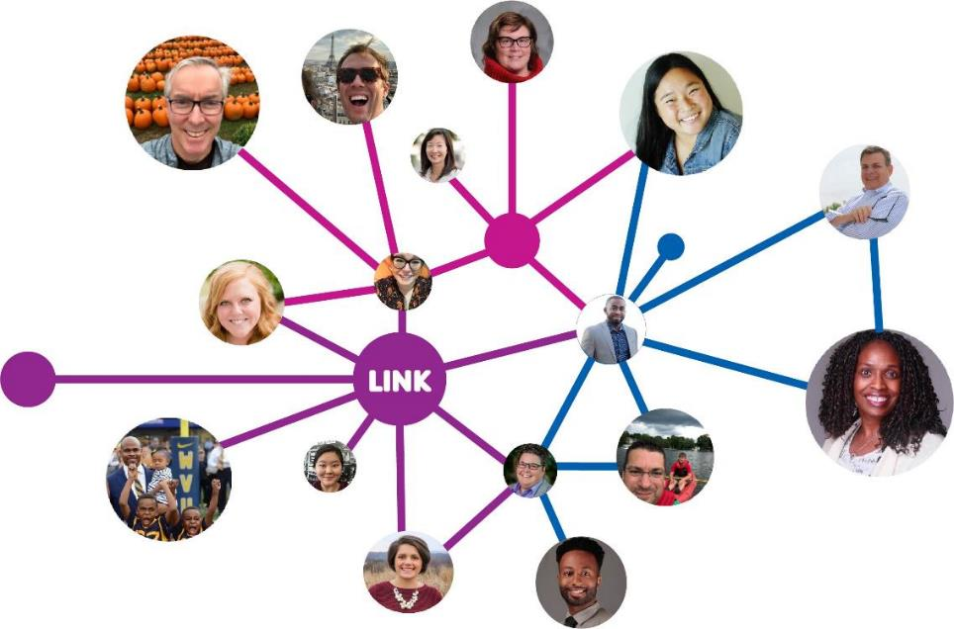
The Power of Knowledge Sharing
What if…
… we all knew what we all know?
Notes:
30 sec
We are all here today because of this big question: What would the power of the Y be if we all knew what we all knew what we all know? I’ll pause for a second so you can ponder that question. What if we all knew what we all know?
Powerful, right? Think about the unique impact we could have in all of the communities we serve with THAT kind of knowledge. In my time working in local Y’s we often talked about not wanting to reinventing the wheel and leveraging (ehem, copying/stealing) resources from other Ys. It is THAT experience that attracted me most to this way of thinking!
Link is the primary tool through which we do this…

Slide 6
What is knowledge?
Knowledge is what we know about our Ys, our communities, our programs, our services, our processes, one another, what works, and what doesn’t.
Some of this knowledge has been around for decades,
while other knowledge is growing and changing every day.
Notes:
Let’s start with the basics: what is knowledge in the context of our work at the YMCA? [CLICK]
Knowledge is what we know about our Ys, our communities, our programs, our services, our processes, one another, what works, and what doesn’t. [CLICK]
Some of this knowledge has been around for decades,
while other knowledge is growing and changing every day. [CLICK NEXT SLIDE]

Slide 7









Knowledge and expertise are plentiful at the Y.
Notes:
Across the organization, there are experts in all areas.
These individuals have built up knowledge about the jobs they do every day – from finance and program delivery, to contracts and COVID procedures.
We all collect experience, tools, and lessons learned about the work we do. [CLICK NEXT SLIDE]

Slide 8




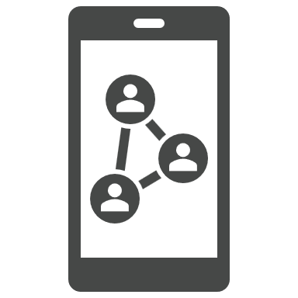




In the moment, documenting and sharing that knowledge can be easier said than done.
Notes:
This knowledge is invaluable, but it’s not always documented in a way that is accessible to others in the organization.
Without a knowledge management system, that valuable information lives in [CLICK] miscellaneous documents, conversations, email threads, and in some cases, it only lives in our heads.
That’s all well and good… until there’s someone in another part of the organization who would benefit from that information… [CLICK NEXT SLIDE]

Slide 9






That can make it hard to find the information and expertise you need, right when and where you need it.
Notes:
Without knowledge management, it’s difficult, if not impossible, for colleagues to find the information they need, when and where they need it.
CLICK
That means there are questions that go unanswered, redundant work, and a lot of wasted time and effort.
This leads to the question… [CLICK NEXT SLIDE]

Slide 10


Link: A tool to support you
Link is a knowledge-sharing and social-networking platform for
the Y.
Designed to empower staff and volunteers to share knowledge and connect with one another in real time
Accessible anytime, anywhere
Personalized communities of Y peers and resources
Notes:
And that’s where Link comes in!
Link is a knowledge-sharing and social-networking platform for Y staff and volunteers at all levels. At its most basic, Link is a collection of approximately 50 online communities.
Link empowers thousands of Y staff and volunteers to connect in real time.
Is available anytime and anywhere with an easy-to-use mobile app.
And it allows you to personalize your experience by joining communities and accessing resources directly relevant to your work.
Link allows you to broaden the reach of the questions you ask and the knowledge that you share. When some asks a questions and others provide an answer, share a resource, or communicate key information, that shared knowledge has the potential to be seen by thousands of Y staff across the country. You can seek out the help you need for your daily work, and event help your own colleagues should you choose to do so, with less effort over time through Link.
Link is also a repository you can tap into to access knowledge from across Y-USA and the Movement. And specific topic area communities, from aquatics to HR and everything in between allow you to connect with and learn from the experiences of others .

Slide 11
Your Role in knowledge sharing
Notes:
Every time you come into L:ink and
Ask or answer another person’s question,
connect a fellow colleague to information or resources, or
facilitate conversations among peers…
You participate in and help build our culture of knowledge sharing at the Y! [CLICK NEXT SLIDE]

Slide 12
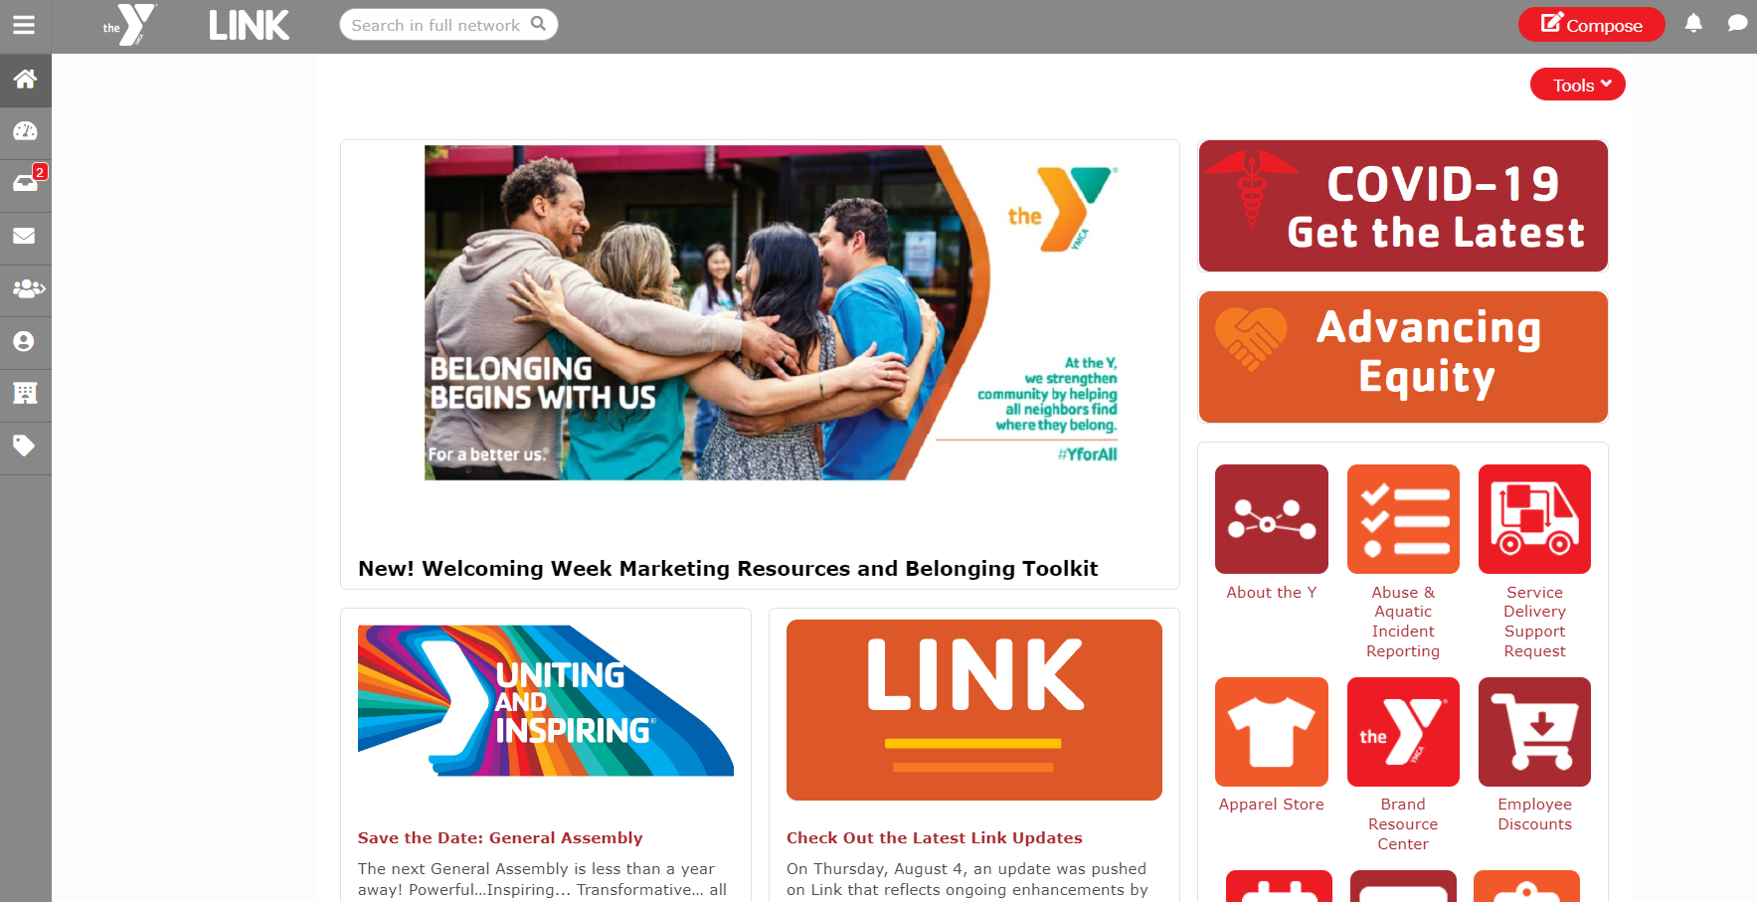
Home page
Notes:
Web presenter
1 min
When you first open Link, you see the home page.
At the top left, you’ll find the featured slider with important information on a variety of timely topic
To its right are the quick link buttons giving you easy access to frequently used applications and websites including the Brand Resource center, Events page and the Learning and Career Development Center.
One of the hidden gems is the Employee Discounts button. Check here for discounts on your cell phone bill and technology.
Scrolling down you’ll see the stay informed section right below the featured slider.
These items are updated weekly so make sure to come back to the homepage often to see the latest news.
Finally, the home page is where you can find additional resources to help you get the most out of Link

Slide 13
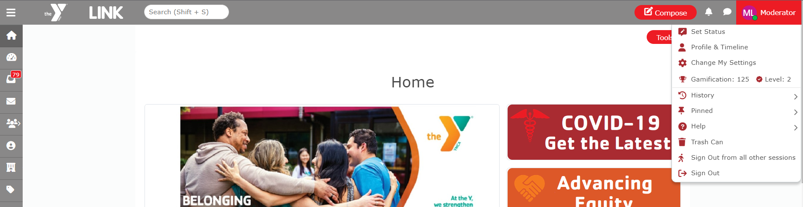
Top navigation
Purpose: Access to the following Link tools
Search: across all of link
Compose button: contribute content
Notifications: view notifications from the communities you’ve joined and people you follow
Chats: view your latest chats or click “View All”
Profile Menu: set a status, change profile picture, view profile, update settings, and access additional tool
  History: shows the recent places you’ve visited in Link
  Pinned: list of items you pinned
  Help: find resources on using Link
Notes:
Web presenter
2 min 30sec
Let me show you these features in Link [switch to Link]
The top navigation bar is available on every page in Link.
Search: across all of link
Compose button: contribute content
Notifications: view notifications from the communities you’ve joined and people you follow
Chats: view your latest chats or click “View All”
Profile Menu: set a status, change profile picture, view profile, update settings, and access additional tools:
History: shows the recent places you’ve visited in Link
Pinned: list of items you pinned
Help: find resources on using Link

Slide 14
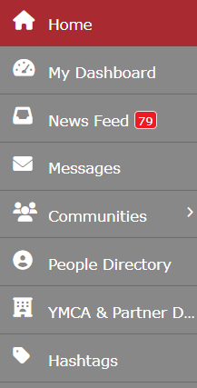
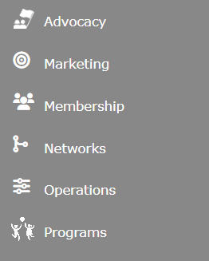

left navigation
Do we want to add a slide that included the Community Categories submenu? If we do, I propose breaking slide 15 into two slides, one to discuss hover and categories, then a second to talk about the community page and filters to segway into finding and joining a community.
Personalized content, activity, and messages
Communities: Explore peer community groups & resources
Directories: find people, YMCAs, partners, and hashtags.
Notes:
Web presenter
2 min 30 sec
The left navigation bar is available on every page in Link and it’s where you’ll find these important Link tools:
The first section where you’ll find personalized content, activity, and messages.
Dashboard: This is your personalized space on Link. If there’s some extra time I will show this later on.
News Feed: Shows activity personalized for you--all communities you belong to and people or hashtags you’re following
Messages: Send private messages to other Link users, similar to an email
The next section is how you navigate to communities.
Communities: The next section is how you navigate to communities. As noted, the Link platform is, at the end of the day, a collection of approximately 50 online communities organized around different topic areas. Clicking on the community button in the left navigation takes you to a list of all of the communities you have joined and/or pinned. Hovering over the community button displays a list of community categories. The first three categories takesyou to one community (e.g., advocacy, marketing). Clicking on the rest takes you to a list of communities that fall in that category (e.g., programs, networks). You can see all communities in Link by clicking on the communities button and changing the filters at the top to show All Categories and All Communities. [Show this]
Next are a few directories:
People Directory: see profiles of all Link users. You can search just people directory and also follow people here
YMCAs and Partners Directory: see profiles of YMCAs. You can search by many criteria such as programs offered or find service-delivery partner Ys here.
Hashtags: Hashtags aggregate like content from all across Link together, much like you see in other social media. Clicking on a hashtag shows you everything tagged with that term.

Slide 15
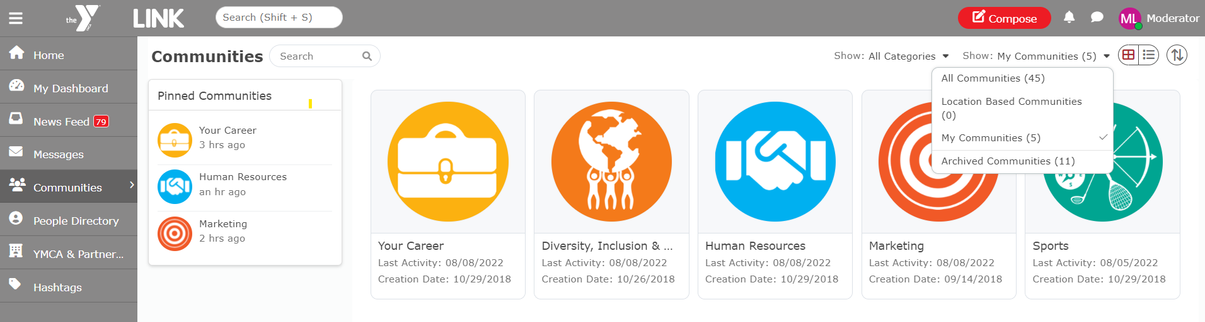
Find A Community
Notes:
1 min
Web presenter
In Link, that knowledge is held in communities. Communities are topical. They reflect the most common work that happens at the Y from programs to operations to important initiatives. You can find a community through Search or via the Communities button on the left navigation. Hovering over the communities button will display a scrollable list of community categories. Some of these lead directly into a community, such as Marketing or Advocacy. Others, like Networks, lead to a page that lists all of the communities that fall in that topic area. When you click on the Communities button you will be taken to a landing page displaying all of the communities you have currently joined and/or pinned. Use the filters at the top of the screen to narrow your community browsing experience.
So let’s go into a community and take a look around.
Go to Link

Slide 16
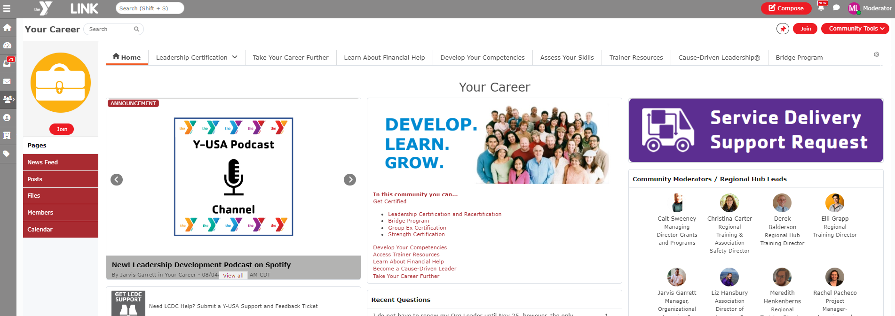
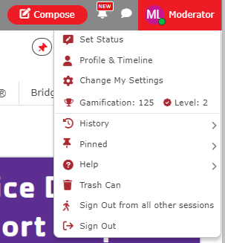
Community At A Glance
Notes:
2 min
Community Level navigation:
Here is where you can find the Community Pages, News Feed specific to the community, Posts within the community, community files, Members in the community, calendar, and leaderboard [gamification shows highly engaged members of the community]. If you have a question or issue, checking the leaderboard is a great place to get connected with people who have demonstrated that they want to share their experience and expertise.
Across the top, next to the Community name is the community level search, as well as the Join button to join the community. Tip: Join the communities most relevant to your work. Joining a community means you want to receive notifications about it. If you join lots of communities, you’ll get lots of notifications, which may drown out the content most relevant to what you do each day. For easy access to the communities most important to you, in addition to joining the community, we recommend pinning the community for easy access from your profile and communities menus.
Below this is the page navigation showing the pages within the community.

Slide 17
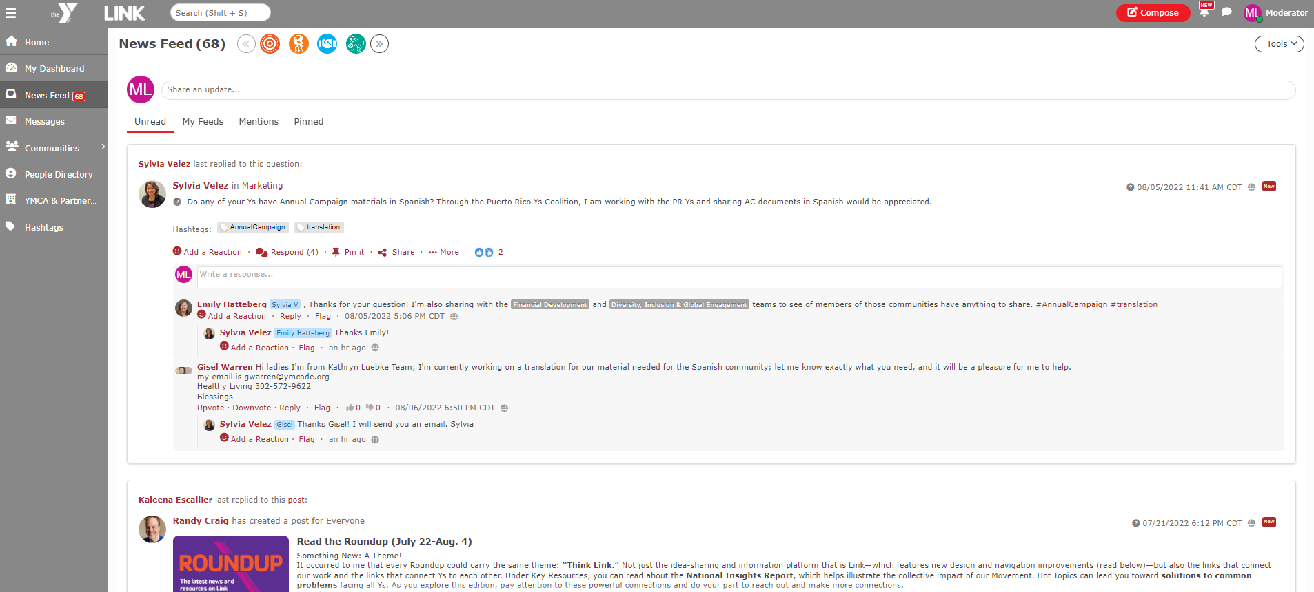
News feed
Notes:
20 sec
We’d like to spend a few moments on the news feed.
Your news feed displays the activity from the communities, people and content you follow.

Slide 18
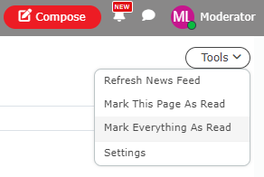
Dissecting Your News Feed
Notes:
1 min 40 sec
Team filters: You can filter specific community feeds that you want to see by clicking on the community icons
Feeds: Click through the 4 feeds at the top to display content from the communities you’ve joined and people that you follow that you have not yet read, all feed items, feeds you or a community yu have joined have been mentioned in, or feeds that you have pinned.
Action row: React to content, add a comment, pin it, or click more to copy the link
---
In the upper right corner click on the 3 dots to access your Feed Settings

Slide 19
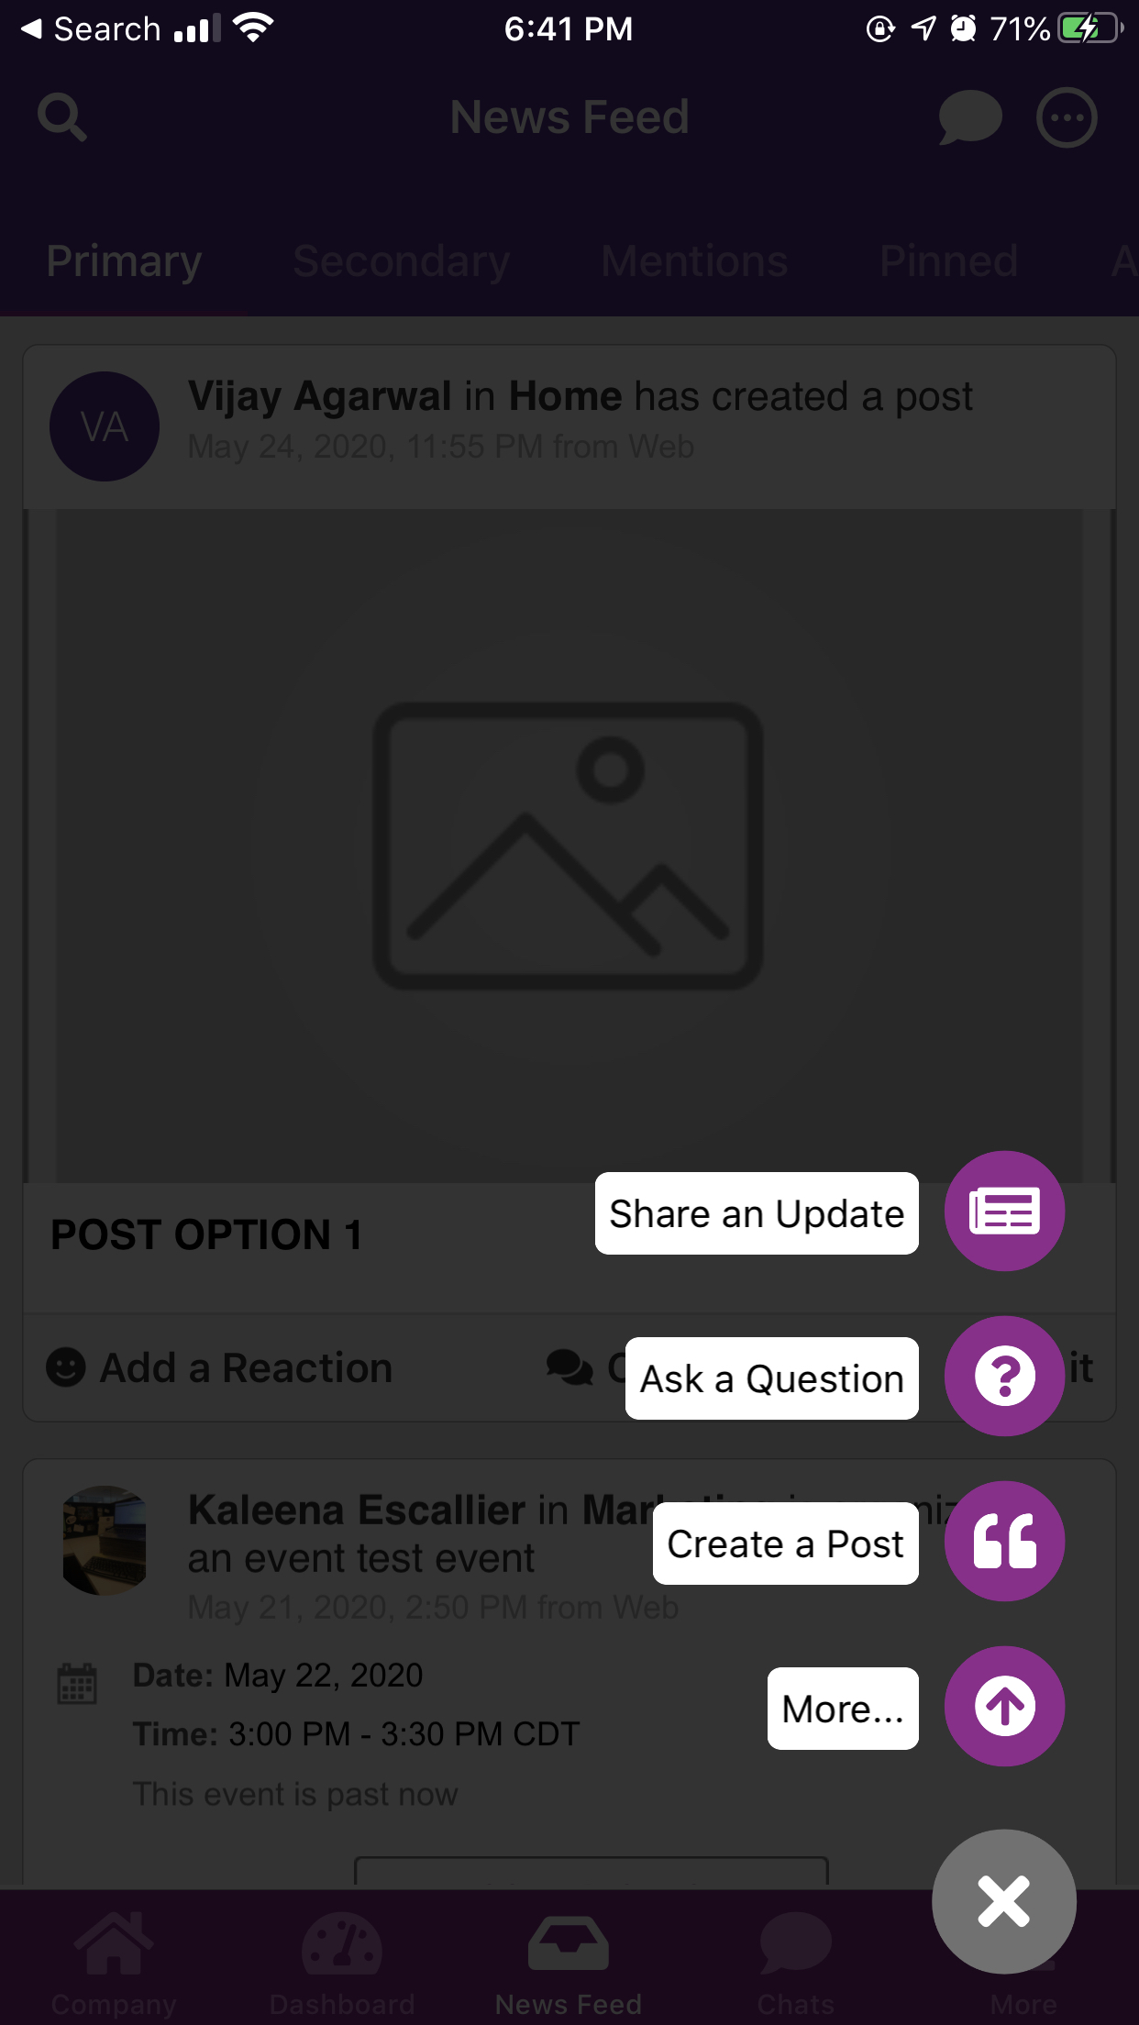
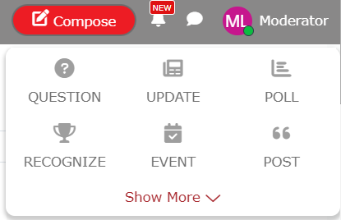
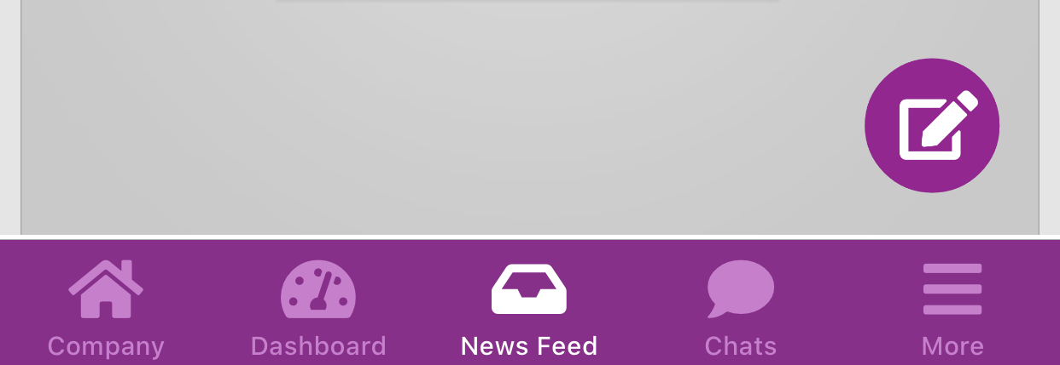
Start New conversations
Compose
Notes:
5 min
Mobile presenter
You contribute through the Compose button.
It appears at the top of every page.
It’s a quick way to add various types of content to communities across the platform.
Today, I will be highlighting the most frequently used items in the Compose button:
Update: use for short, informal, more personal conversation. Updates are plain text with little formatting availability. You can attach files.
Question: allows anyone to ask a question and receive answers from the community. Those answers can be upvoted and downvoted. You can also attach files to questions too.
Poll: An easy way to get input from other Y staff and a fun way to engage in the community.
Recognize: Any user can give recognition to publicly thank, congratulate, or applaud another person or even community.
Let’s talk a little bit about each of these: Switch to Link
Suppose that you want to share an update in Before & Afterschool community [go to that]. You go to that community and
Click Compose > Update
Say: When you are already in a community the name will show up in the Team box.
Show: Add the Youth Program Enhancement by typing in the name and selecting Youth Program Enhancement
Enter text: Our Living Our Cause workshop was attended by 25 engaged afterschool staff.
Show how to attach a file – select a picture.
DO NOT CLICK SHARE
Click the X in top right to close out the Update
To ask a question,
Click Question. This is very similar to an update, except you’re asking a question. Do not enter any text.
To create a poll,
Click Poll. Say but don’t enter anything: You’ll select the teams or communities you want the poll to display in, and add your question. It’s easy to make custom options. Simply separate your choices with a comma. You can select additional advanced options. We suggest keeping the default ability to add comments.
Close the Poll. Open an existing poll in Before & Afterschool.
Say: this is what a finished poll looks like. You can vote and see the results.
Lastly, I’ll show you how to Recognize your fellow staff and volunteers so that it shows up in the Recognition widget in the community.
Indicate the Recognition widget in Before & Afterschool.
Click Compose > Recognize.
Say: On the left, you’ll see a variety of different recognitions to choose from. Pick the recognition, you’d like.
Next, you’ll tell Link who to give that recognition too. We HIGHLY ENCOURAGE that you first select Team so that the recognition shows up in the community. Then, you’ll select Give to specific team members. Select the staff or volunteers. You can select more than one. Say: If you do not pick a team and select People. It will show in that person’s profile and they will get a notification, but it will NOT be seen in the community. We love to give visible recognition, which is why we encourage to select Team!
Lastly, enter your personalized message.
DO NOT CLICK GIVE.
Say: and click the Give button.
Indicate and say: This recognition will appear in the Recognition widget.

Slide 20
activity
Update information on your profile
Add a photo
Add expertise and skills
Add your supervisor to build your Org Chart
Notes:
(As Time Allows – can invite them to grab a photo of this slide and complete after the presentation)
5 min
Before opening things up to questions, I have a just a few items as we conclude this training session.
First, we have a challenge for you.

Slide 21
resources
Video Tour
Link overview
Link Resources
Link help and resources page contains short videos and help documentation
Account Set Up resources – invite a colleague to Link!
Link User Guide
How-to
Detailed info on functionality
Link Feedback & Support
Request a tech ticket for help or leave feedback
Notes:
1 min
Mobile presenter
Want to learn more?
On the top navigation bar, click the profile menu and then hover over the Help menu.
Here you’ll find the user guide, help documentation, a list of all Link communities, and a video tour that will give you a more thorough orientation to Link than we did today.
We have also recently added a Link is Mobile video that you’ll definitely want to take a look at once you download the mobile app.
Also remember that, as you and others share your expertise and resources, even more content will be available in the various communities. So lots of reasons to keep coming back!

Slide 22
Remember…
LINK IS YOURS
The more you participate, the more valuable and relevant it becomes.
Notes:
30 sec
Mobile presenter
One last thought to leave you with…

Slide 23
questions

Slide 24
Thank You
Knowledge Management Team
YMCA OF THE USA
800 872 9622
Link@ymca.net

Slide 25

link Communities
Advocacy
Marketing*
Membership*
Networks
African-American Resource Network**
Asian Pacific Islander Leadership Network**
Emerging Leaders Resource Network**
Hispanic-Latino Leadership Network**
LGBTQ Resource Network**
Women's Leadership Resource Network**
YMCA Professional Network (YPN)
Operations
About the Y
CEO (private)
Diversity, Inclusion, and Global*
Facilities and Real Estate*
Financial Development*
Fiscal Management*
Information Technology*
Innovation
Network Partners
Research, Analytics, and Insights
Risk Management*
Strategic Planning
Vendors & Merchandise*
Programs
Aquatics*
Before and Afterschool*
Camp*
Early Childhood*
Health & Wellness*
Sports*
Teens*
Youth Program Enhancement*
Staff Development
Human Resources*
Multicultural Leadership Development*
Your Career***
Volunteers
Board Governance
Program Volunteers
*Moderated by Local Y Moderators and/or partner organization Moderators
**Moderated by ERG Board Members
***Moderated by Service Delivery Hubs
Tip
Join only communities most relevant to your work and interests.

